Slide 1
Employee Data Analysis using Excel
STUDENT NAME: LATHIKA.V
REGISTER NO: 312204096 ( 5D30B88F26CB8EF8A144A5065D26ACEC) )DEPARTMENT: B.COM (COMMERCE )
COLLEGE : SRIRAM COLLEGE OF ARTS & SCIENCE

Slide 2
PROJECT TITLE
Employee Salary Analysis using Excel

Slide 3


AGENDA
Problem Statement
Project Overview
End Users
Our Solution and Proposition
Dataset Description
Modelling Approach
Results and Discussion
Conclusion
3/21/2024 Annual Review

Slide 4

PROBLEM STATEMENT
Certainly! Could you please provide more details about the problem statement related to employee salaries? For instance, are you looking for help with calculating salaries, creating a salary structure, addressing discrepancies, or something else? The more specifics you provide, the better I can assist you.

Slide 5

PROJECT OVERVIEW
project overview for an employee salary management system could include the following components:
1. Project Purpose:
To design and implement a system for managing employee salaries that ensures accuracy, compliance, and efficiency in salary processing.
.
. Objectives:
Accurate Calculation: Automate the calculation of salaries, including deductions, bonuses, and overtime.
Compliance: Ensure adherence to legal and regulatory requirements for payroll processing.
Efficiency: Streamline salary processing to minimize manual effort and errors.
Transparency: Provide clear reports and access to employees regarding their salary details.
Security: Safeguard sensitive salary information from unauthorized access

Slide 6

WHO ARE THE END USERS?
HR Personnel
Payroll Administrators
Finance Department
Employees
Compliance Officers
Auditors

Slide 7

OUR SOLUTION AND ITS VALUE PROPOSITION
Our Solution
Automatic Salary Calculations: Includes base salary, bonuses, overtime, and deductions.
Comprehensive Reporting:
Detailed Payroll Reports: Includes expenditure, tax summaries, and benefits.
Secure Data Management:
Data Encryption: Protects sensitive salary and personal information.
Value Proposition:
Accuracy and Efficiency:
Benefit: Reduces manual errors and administrative workload by automating payroll calculations and processing.
Compliance and Risk Mitigation:
Benefit: Keeps payroll operations in line with current regulations and tax laws, minimizing legal risks.

Slide 8
Dataset Description
Employee Information:
Employee ID: A unique identifier for each employee.
Name: Full name of the employee.
Department: The department or team the employee belongs to.
Position/Title: Job title or role of the employee.
Date of Joining: When the employee started with the company.
Contact Information: Phone number, email address, and possibly home address.
. Salary Details:
Base Salary: The regular salary paid to the employee before any bonuses or deductions.
Bonus: Additional payments based on performance or company policy.
. Tax and Benefits Information:
Taxable Income: Portion of the salary subject to tax.
Payroll Information:
Pay Period: The timeframe for which the salary is paid (e.g., monthly, bi-weekly).

Slide 9

THE "WOW" IN OUR SOLUTION
Comprehensive Data Integration:
Feature: Centralized Excel workbook consolidates all salary-related data in one place.
Real-Time Updates:
Feature: Easy updates and modifications to salary data as soon as changes occur.
Automated Calculations:
Feature: Use of built-in Excel formulas and functions for automatic salary calculations, including gross and net salaries, taxes, and deductions.
User-Friendly Interface:
Feature: Intuitive layout with clear headings, data validation, and conditional formatting.
Secure Data Handling:
Feature: Password protection and sheet-level permissions to safeguard sensitive salary information.
3/21/2024 Annual Review
9

Slide 10
MODELLING
Modeling an employee salary management system in Excel involves creating a structured and dynamic spreadsheet that effectively manages and calculates various salary-related components. Here’s a step-by-step guide to help you set up and model your employee salary system:
Create the Basic Structure
Setup Sheets:
Employee Information: Stores details about employees.
Salary Calculation: Handles the calculation of salaries, bonuses, and deductions.
Payroll History: Records historical payroll data.
Tax and Benefits: Manages tax deductions and benefits information.
Compliance and Legal: Tracks compliance-related data.
10

Slide 11
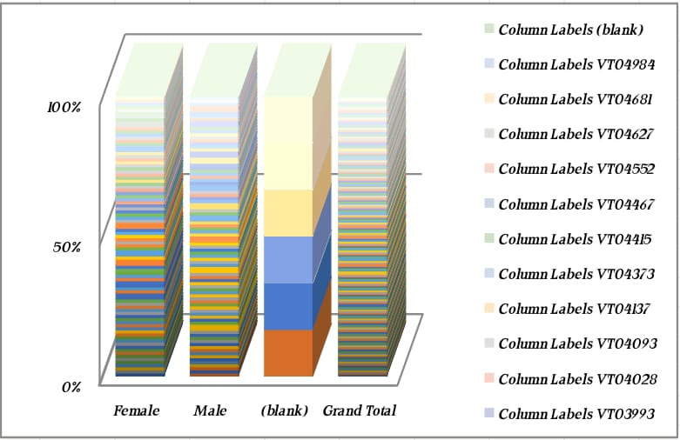
RESULTS
11

Slide 12
conclusion
Employee Salary Management Using Excel Effectiveness: Using Excel for employee salary management offers a versatile and cost-effective solution for tracking and processing payroll. By leveraging Excel’s capabilities, organizations can streamline salary calculations, maintain comprehensive records, and generate insightful reports. This approach is especially advantageous for small to medium-sized businesses or those seeking an affordable alternative to specialized payroll software.

